Slide 1
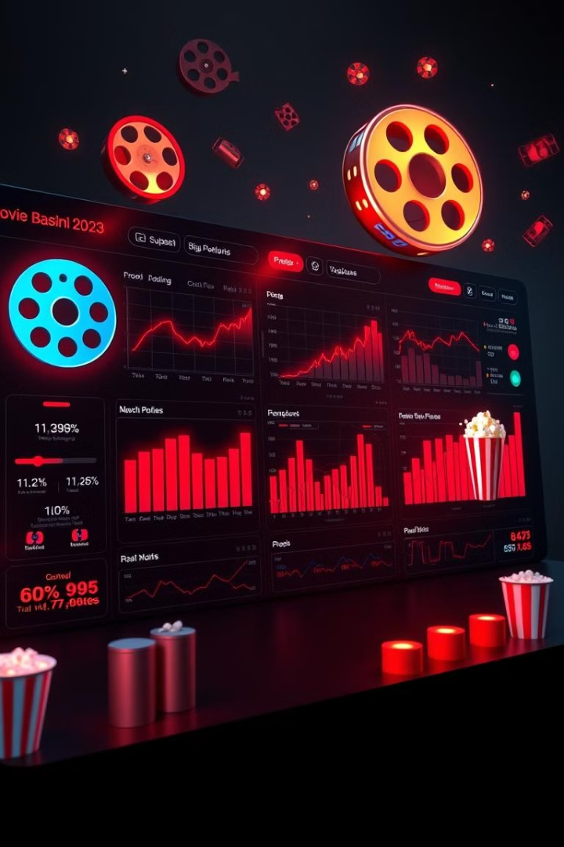

Movie - Analysis , Recommendation and Success Prediction
Submitted By
Abhinav P

Slide 2

Project Overview
The Movie Analysis, Recommendation, and Success Prediction project provides insights into the movie industry using data-driven techniques. By leveraging historical movie data, it analyzes factors influencing a film’s performance, predicts success, and recommends movies based on user preferences.
The analysis focuses on financial metrics, audience engagement, and genre trends. A recommendation system suggests movies based on genre preferences. The success prediction model uses machine learning to forecast a movie's outcome based on attributes like budget, revenue, popularity, and ratings.
This project assists filmmakers, producers, and analysts in making informed decisions about movie investments and marketing strategies.

Slide 3




Objectives
Movie Data Analysis & Insights
Movie Recommend-
ation System
Movie Success Prediction
Analyze movie genre trends and success factors using machine learning.
Genre-based movie recommendations via a Power BI dashboard.
Predict movie success using machine learning models.

Slide 4
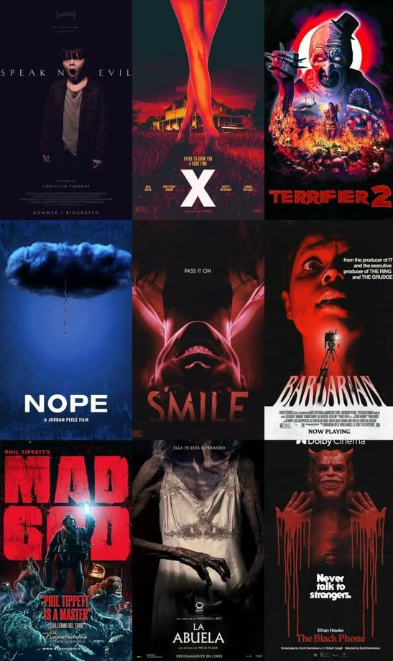
About dataset
Movie Dataset
The Movie dataset contains information about various films, including financial, popularity, and rating metrics.
Source of data
Kaggle

Slide 5



Key Columns
Financials
Ratings & Popularity
Movie Attributes
Budget: Production cost.
Popularity: Popularity score.
Adult: Adult movie (T/F).
Revenue: Total earnings.
Vote Average: Average rating.
Runtime: Movie length.
Profit: Net earnings.
Vote Count: Total votes.
Video: Video exists (T/F).
Success: Movie success.

Slide 6

Movie Success Prediction
Predicting movie success using data analysis and machine learning.

Slide 7



Website Design
Intuitive Interface
Machine Learning Model
Prediction Factors
Streamlit provides a user-friendly interface.
Developed in Jupyter Notebook with Python.
Users input factors and receive predictions.

Slide 8






Dataset Process
Data Collection
Data Cleaning
Data Preprocessing
Classifier Selection
Model Building
Prediction

Slide 9
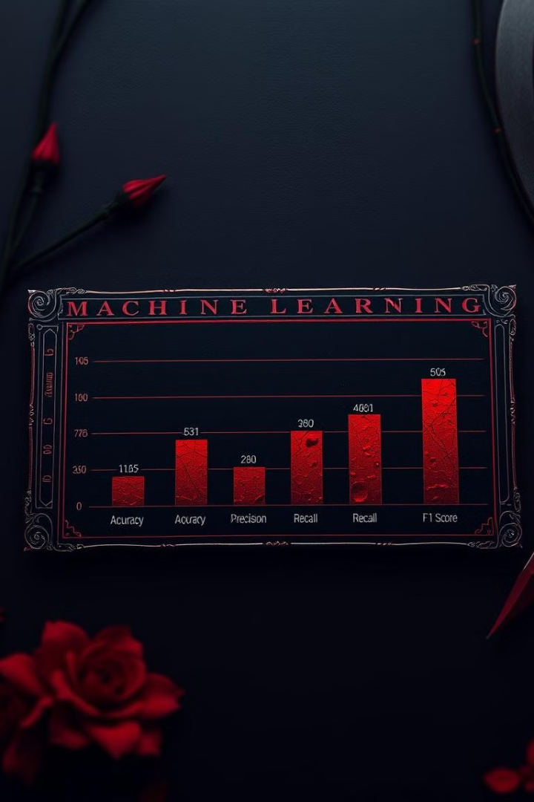
Comparison Table
Model
Accuracy
Precision
Recall
F1-Score
Logistic
Regression
75.30%
76.27%
75.30%
74.25%
Decision
Tree
70.33%
70.27%
70.33%
70.30%
Random
Forest
76.37%
76.34%
76.37%
76.02%
RandomForestClassifier performed best. It achieved 76.37% accuracy.

Slide 10
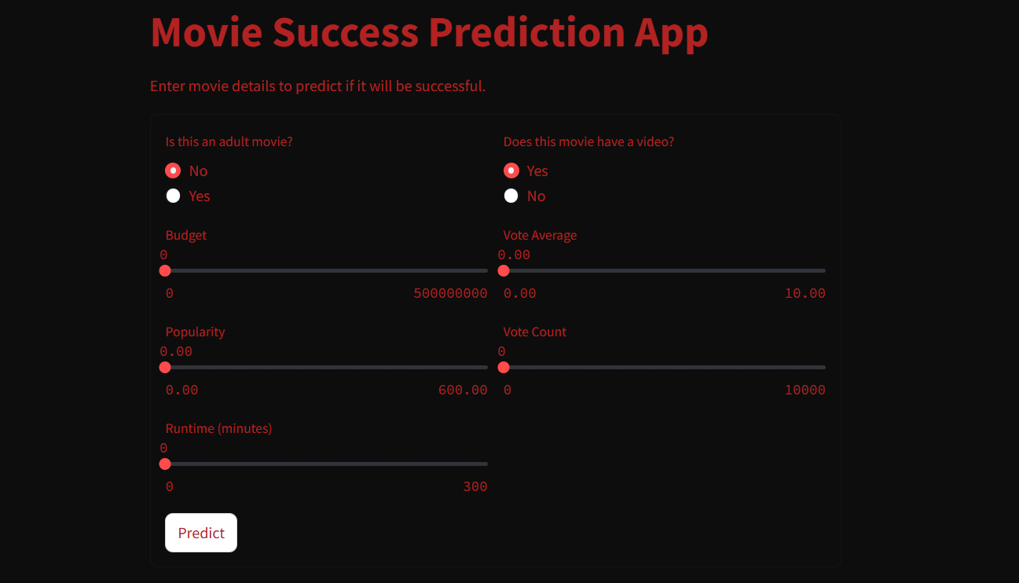
User Interface

Slide 11
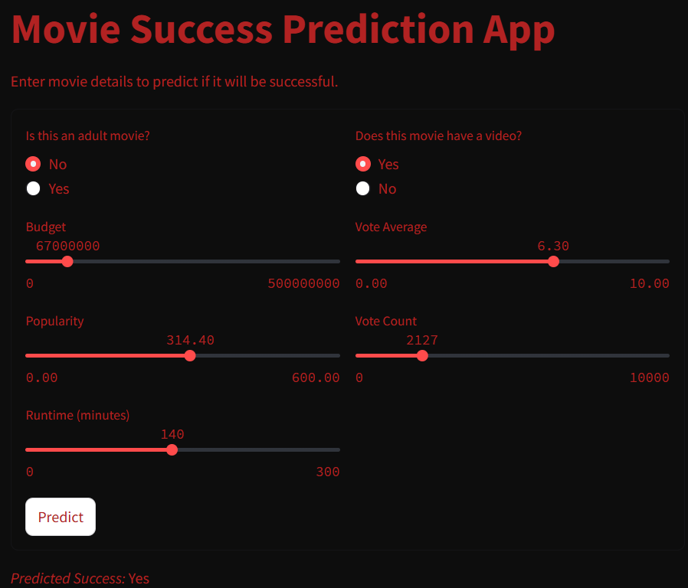
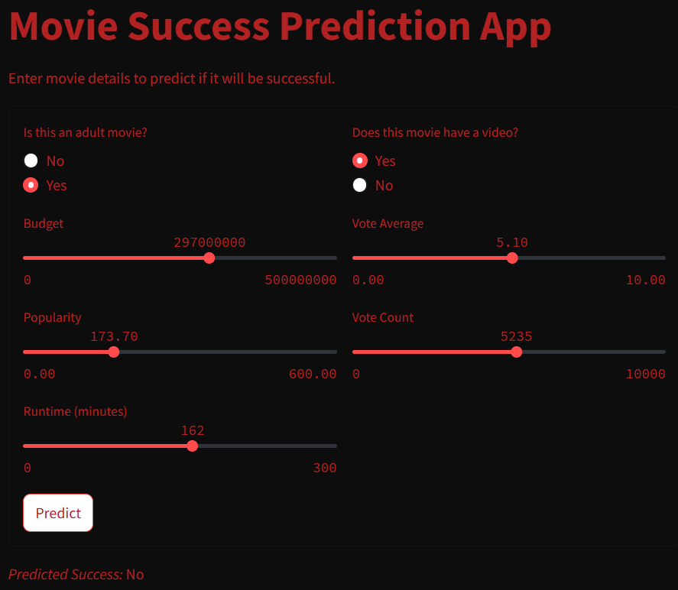

Slide 12



Inference
The trained models (Logistic Regression, Decision Tree, and Random Forest) show that machine learning can effectively predict movie success with reasonable accuracy.
Budget, revenue, popularity, and audience ratings significantly impact a movie’s success.

Slide 13




Possible Future Works
Revenue & Profit Prediction
Trend Forecasting
Investment Advisory Tool
Time-series analysis forecasts future movie trends.
Regression models predict expected revenue or profit.
ML model advises on movie investments.
Predicts success for genres, actors, or directors.
Studios input movies and receive success scores.
Estimates a movie's earnings pre-release.

Slide 14

Movie Analysis and
Recommendation
Dashboard
(2000-2024)
d

Slide 15









Criteria's used
COUNT OF MOVIES BY TOP 10 GENRE
→ Bar Chart
SUCCESS RATIO
→ Donut Chart
TOP GROSSED MOVIES AND THEIR RATING
→ Horizontal Bar Chart
TOP RATED MOVIES → Table
BUDGET AND REVENUE BY YEAR
→ Line Chart
TOP GROSSED PRODUCTION COMPANY
→ Tree map
TOTAL REVENUE
→ KPI Metrics Card
TOTAL MOVIES
→ Card
GENRE 1 → Slicer
GENRE 2 → Slicer

Slide 16
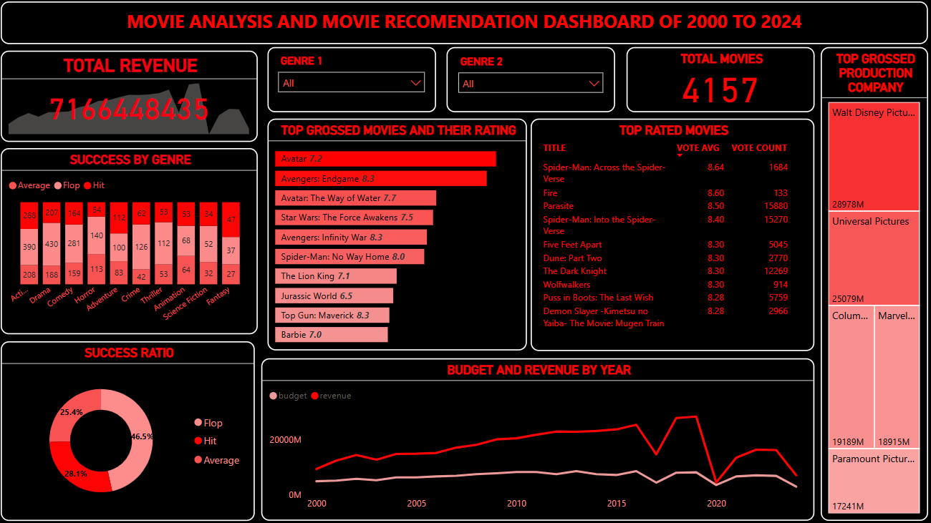
Dashboard Overview
Key Metrics
The dashboard tracks key performance indicators including revenue, ratings, genre success, etc. This Also acts as a Movie Recommendation System based on Genre’s .

Slide 17

Revenue Insights
Total Revenue
Revenue Peaks
Total revenue reached $7.16 Billion. This shows a significant growth over the years.
Peaks align with blockbuster releases. For example, Avatar or Marvel Avengers movies.
Top Studios
Disney, Universal Pictures, and Columbia Pictures dominate. These studios lead in revenue generation.

Slide 18
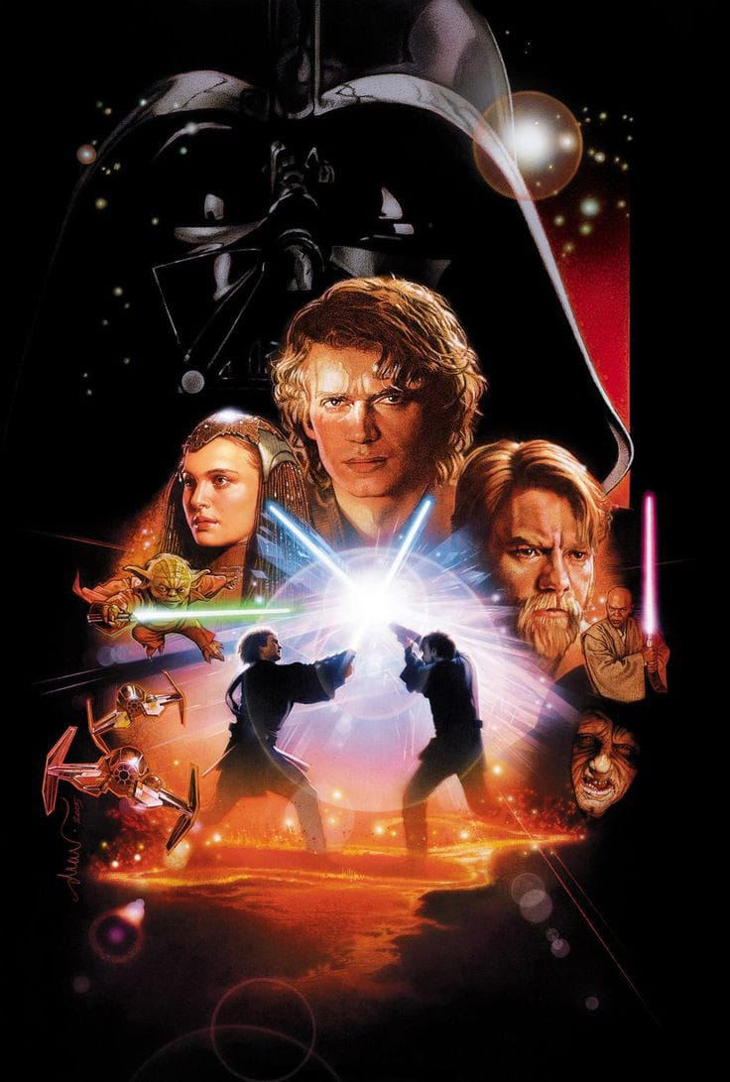








Top Grossing & Rated Movies
Avatar
Marvel
Diverse Genres
Leads with high gross revenue. It also has a strong rating of 7.2.
Avengers and Spider-Man dominate charts. These movies show huge audience engagement.
Movies like Parasite and Dune: Part Two. These represent diverse genres with strong success.

Slide 19




Success by Genre
1
Action, Drama, Comedy
Most frequent genres in the film industry. These genres draw reliable audiences.
2
Sci-Fi and Fantasy
Lower movie counts but higher success. These genres offer unique stories.
3
Flop Rate
Approximately over 50% flop rate. Highlighting risky investments in film.

Slide 20
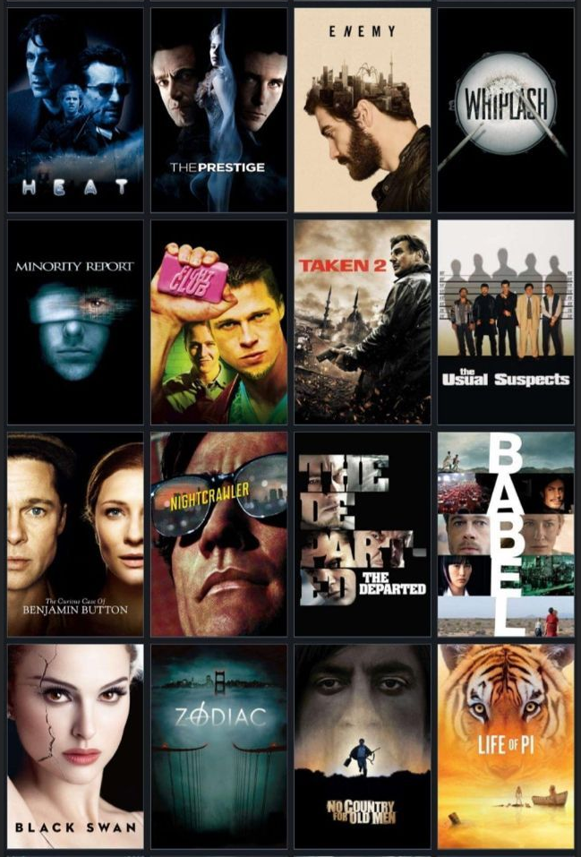



Budget & Revenue Trends
Revenue Surpasses Budget
Overall, revenue exceeds budgets. But note occasional market fluctuations.
Blockbuster Alignment
Major revenue spikes align with big releases. Showing the power of blockbusters.
Post-2020 Decline
Movies show a decline post-2020. Due to market shifts, COVID-19 impact.

Slide 21

Conclusion & Recommendations
1
Blockbuster Focus
2
Genre Investment
Blockbusters drive revenue. Studios should aim for high-impact releases.
Continue investing in Action & Sci-Fi. These genres show consistent returns.
3
Audience Monitoring
4
Franchise Storytelling
Monitor audience trends. Use ratings to enhance success.
Invest in franchise stories. Proven to engage audiences and generate revenue.

Slide 22

Thank You!
Thank you for your time and attention!

